Slide 1
Analysis of Political Sentiments on Twitter using Deep Learning
Submitted By:
Mohd Bilal Aziz (15BCS0024)
Himanshu Mehra (15BCS0020)
Karan Pratap Singh (15BCS0021)

Slide 2
ABSTRACT
In this project, we will discuss a variety of issues related to opinion mining from micro posts, and the challenges they impose on an NLP system, along with an example application we have developed to determine political leanings from a set of pre-election tweets. While there are a number of sentiment analysis tools available which summarize positive, negative and neutral tweets about a given keyword or topic, these tools generally produce poor results, and operate in a fairly simplistic way, using only the presence of certain positive and negative adjectives as indicators, or simple learning techniques which do not work well on short micro posts.
Our methods make use of a variety of sophisticated NLP techniques in order to extract more meaningful and higher quality opinions and incorporate extra-linguistic contextual information.
Recurrent Neural Networks and Long Short-Term networks are both models that are often used for sentiment analysis. The goal of this research is to ﬁnd out why these models work well for sentiment analysis and how these models work. Recurrent Neural Networks and Long Short-Term networks introduce a memory into the model.

Slide 3
INTRODUCTION
In this project, we discuss a variety of issues related to opinion mining from micro posts, and the challenges they impose on a Natural Language Processing (NLP) system, along with an example application we have developed to divulge political leanings from a set of pre-election tweets.
This kind of predictive analysis is all about understanding one’s potential audience at a much deeper level, which can lead to improved advertising techniques, such as personalized advertisements to different groups.
For example, if many people talk on social media sites about fears in airline security, life insurance companies might consider opportunities to sell a new service.
.

Slide 4
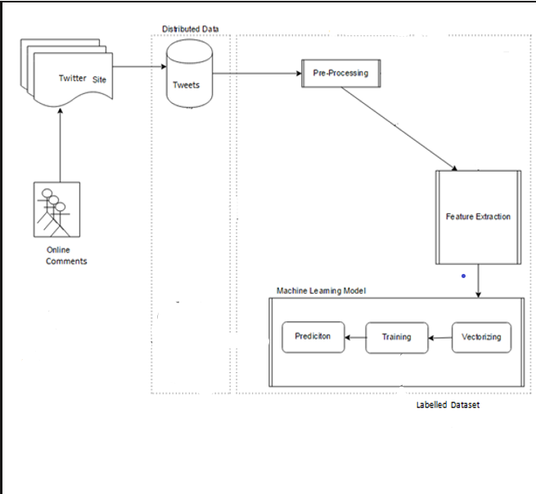
Our Proposed Framework

Slide 5
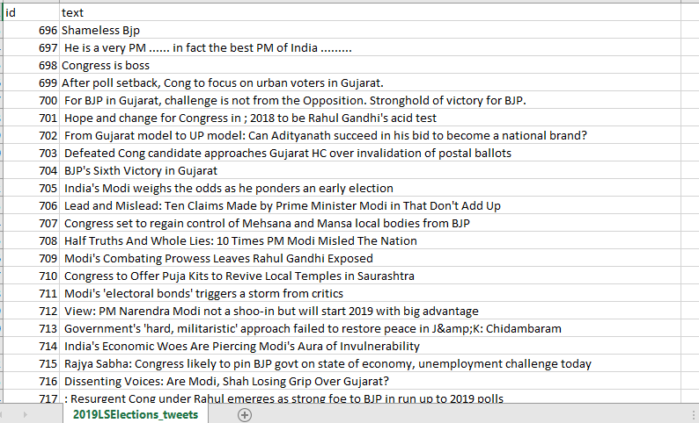
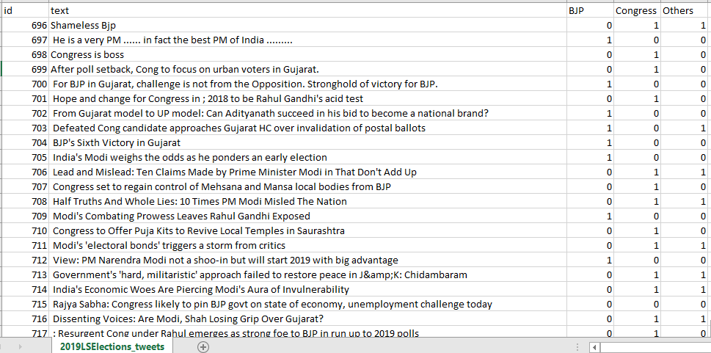
Phase 1: Data Scraping

Slide 6
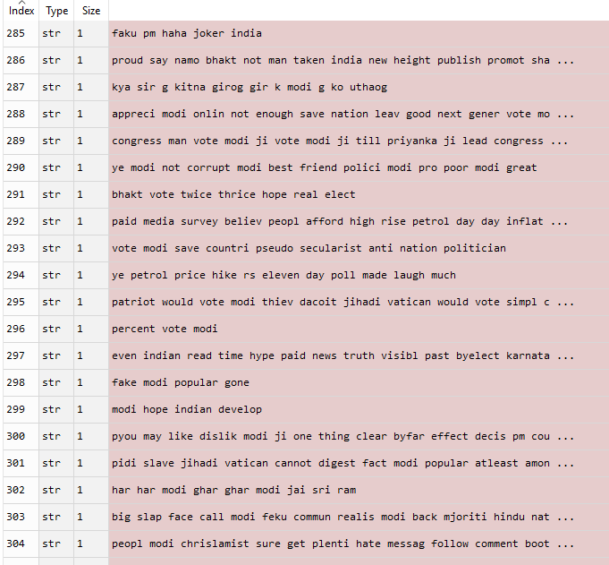
Phase 2: Data Preprocessing
Collecting the data from twitter handle of different users.
The Political sentiments are classified according to type of comments.

Slide 7
Phase 3: Feature Extraction
Count Vectorizer- It provides a simple way to both tokenize a collection of text documents and build a vocabulary of known words, but also to encode new documents using that vocabulary.
TF-IDF Vectorizer- TF-IDF stands for term frequency-inverse document frequency, and the TF-IDF weight is a weight often used in information retrieval and text mining. This weight is a statistical measure used to evaluate how important a word is to a document in a collection or corpus.
Word2Vec- Word2vec is a two-layer neural net that processes text. Its input is a text corpus and its output is a set of vectors: feature vectors for words in that corpus.

Slide 8

How to compute TF and IDF?
TF: Term Frequency,
TF(t) = (Number of times term t appears in a document) / (Total number of terms in the document).
IDF: Inverse Document Frequency,
IDF(t) = ln(Total number of documents / Number of documents with term t in it).

Slide 9
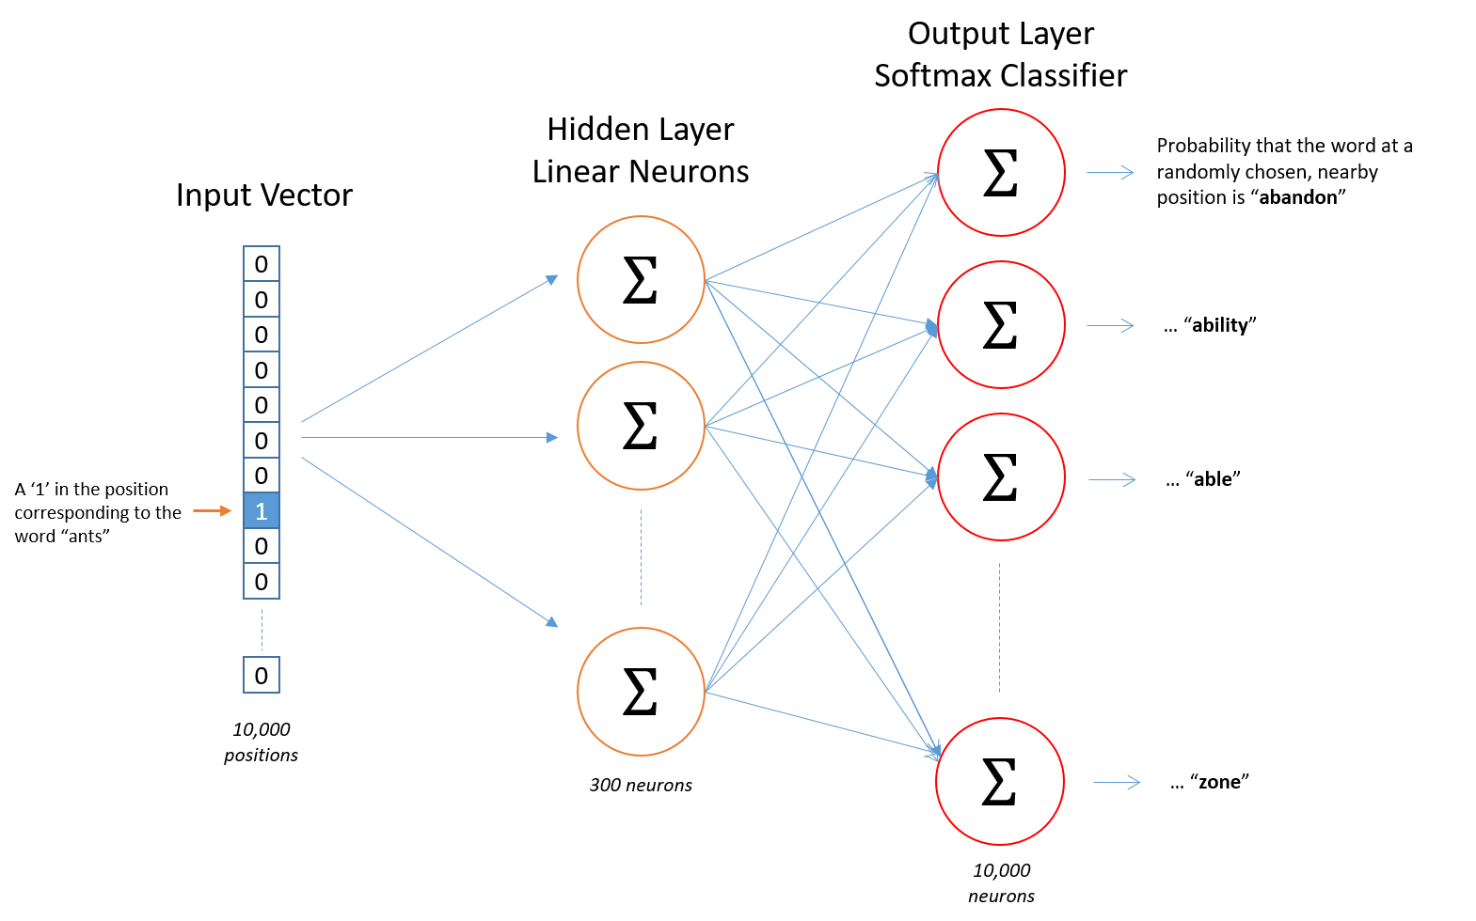
How to compute Word2Vec?
The input is a one-hot vector representing the input word and the training output is also a one-hot vector representing the output word. But when we evaluate the trained network on an input word, the output vector will actually be a probability distribution (i.e., a bunch of floating point values, not a one-hot vector).

Slide 10
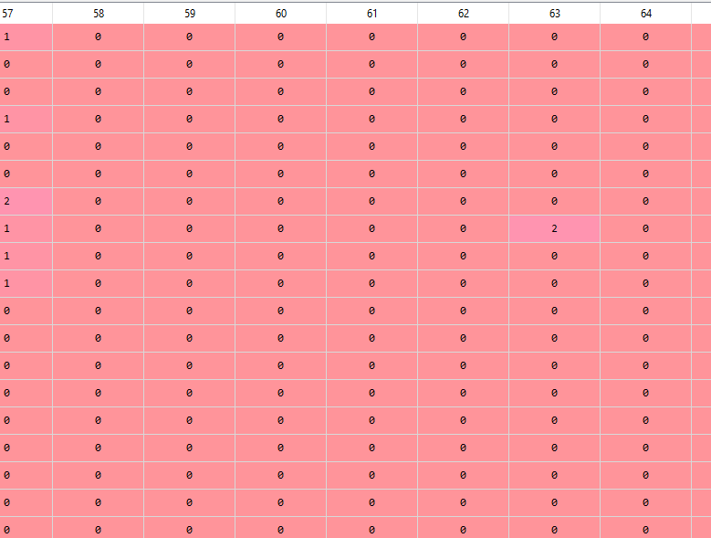
Text representation using Count Vectorizer
500 most frequent words are extracted.
The words are represented at their corresponding indexes as their counts in the corpus.

Slide 11
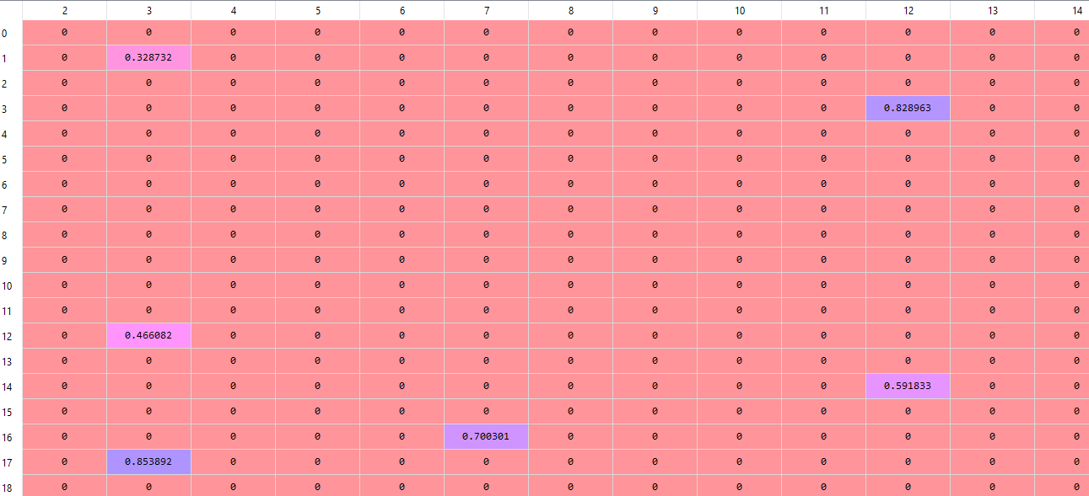
Text representation using TF-IDF Vectorizer
200 words are extracted.
Words are represented at their corresponding indexes as their TF-IDF score.

Slide 12
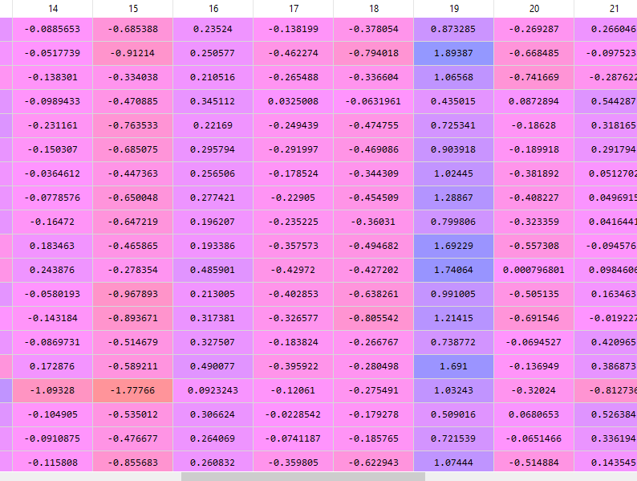
Text representation using Word2Vec
2694 words are chosen and each word is represented using 50 dimensions.
These words are concatenated according to the comments in the corpus.

Slide 13
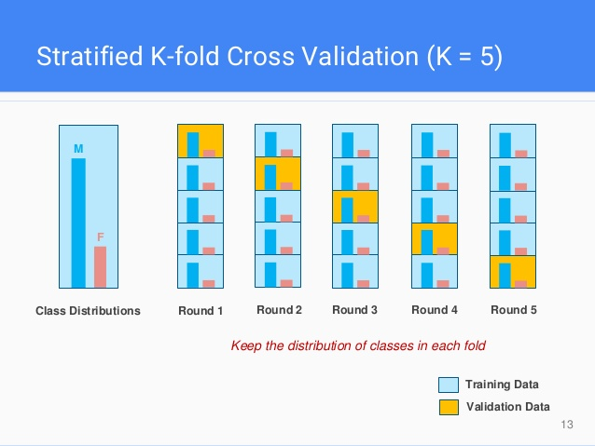
Stratified K-fold cross validation
Stratification is the process of rearranging the data as to ensure each fold is a good representative of the whole.

Slide 14
Phase 3: Classification
Logistic Regression (LR)
Support Vector Machine (SVC)
Random Forest Classification (RFC)
Decision Tree Classification (DTC)
Long Short-Term Networks (LSTM)
Artificial Neural Networks (ANN)

Slide 15
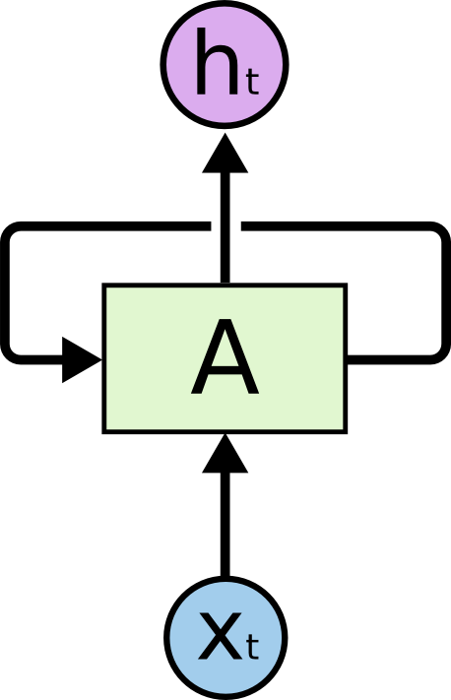
Recurrent Neural Networks
First algorithm that remembers its input, due to an internal memory, which makes it perfectly suited for Machine Learning problems that involve sequential data.
It produces output, copies that output and loops it back into the network.
Therefore a Recurrent Neural Network has two inputs, the present and the recent past. This is important because the sequence of data contains crucial information about what is coming next, which is why a RNN can do things other algorithms can’t.

Slide 16
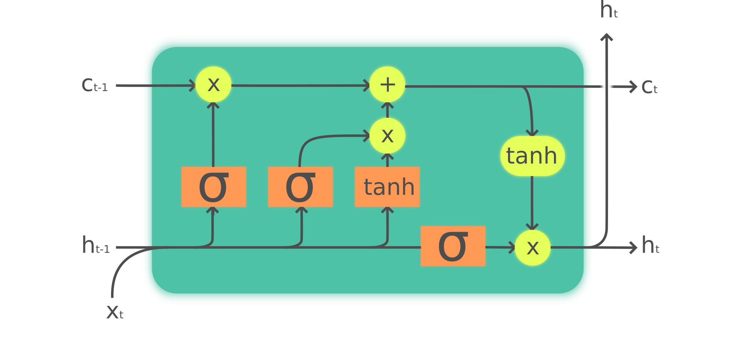
Long-Short Term Memory
Long Short-Term Memory (LSTM) networks are an extension for recurrent neural networks, which basically extends their memory. Therefore it is well suited to learn from important experiences that have very long time lags in between.
LSTM’s enable RNN’s to remember their inputs over a long period of time. This is because LSTM’s contain their information in a memory, that is much like the memory of a computer because the LSTM can read, write and delete information from its memory.

Slide 17
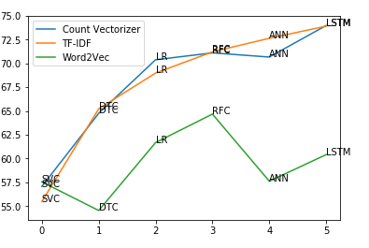
Performance of different classification algorithms by using different Feature Extraction method
According to the graph, LSTM is performing same for both the feature extraction method, i.e., Count Vectorizer and TF-IDF.
However, ANN performed well for TF-IDF rather than Count Vectorizer.

Slide 18
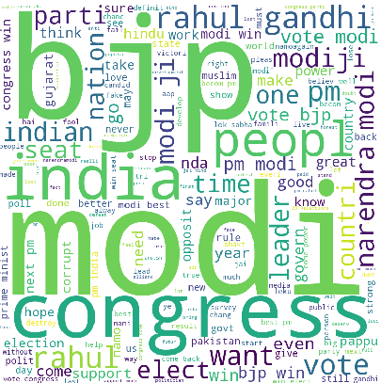
Word Cloud
It is most commonly used to highlight popular or trending terms based on frequency of use and prominence.

Slide 19
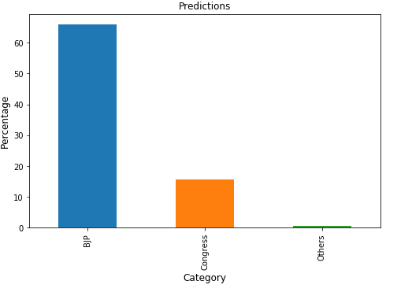
Predictions
It is found that 66% of the online polls favor BJP, whereas 15% of the online polls favor Congress.
However, the predictions are not that accurate because the maximum accuracy achieved is 74% by LSTM.
Still taking care of all the above measures, it can be concluded that BJP might win the coming 2019 Lok Sabha Elections.

Slide 20
References
Boiy, E., Moens, M.F.: A machine learning approach to sentiment analysis in multilingual web texts. Information Retrieval 12(5) (2017) 526–558
Mullaly, A., Gagne, C., Spalding, T., Marchak, K.: Examining ambiguous adjectives in adjective-noun phrases: Evidence for representation as a shared core- meaning. The Mental Lexicon 5(1) (2018) 87–114
Weichsel Braun, A., Gindl, S., Scharl, A. : A context-dependent supervised learning approach to sentiment detection in large textual databases. Journal of Information and Data Management 1(3) (2016) 329–342
Cunningham, H., Maynard, D., Bontcheva, K., Tablan, V.: GATE: A Framework and Graphical Development Environment for Robust NLP Tools and Applications. In: Proceedings of the 40th Anniversary Meeting of the Association for Computational Linguistics (ACL’02). (2017)

Slide 21
Thank You

